Slide 1
Matrix Chain Multiplication

Slide 2
Let A1, A2, A3 and A4 are 4 different matrix.
A1= ( 5*4)
A2= (4*6)
A3= (6*2)
A4= (2*7)
* =
Total multiplication required = 5*4*6 =120 = cost of multiplying 2 matrix.
To get this element we need 4 multiplication
5*4
4*6
5*6

Slide 3
Which pair of matrices I will select, so that the cost is minimum.
The problem is not only to multiply matrices but also how to multiply different matrices.
(((A1.A2)A3)A4)
((A1A2)(A3A4))
How many parenthesization possibilities?
T(n) = 2nC_{n}
_{n+1}
_{For 3 nodes = 5.}
A4
A3
A1
A2
A3
A4
A1
A2

Slide 4
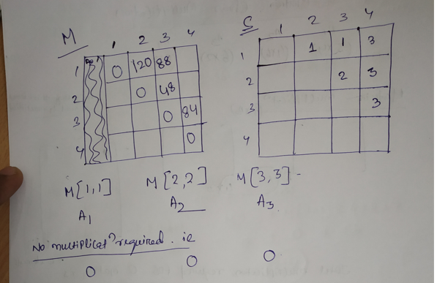

Slide 5
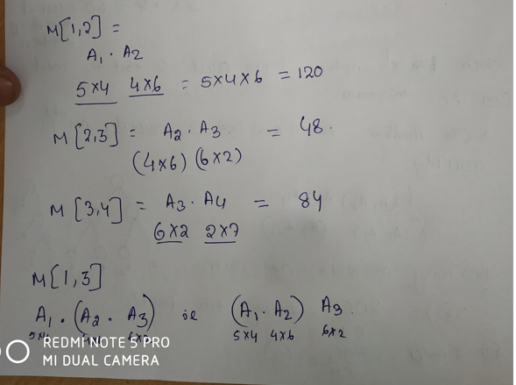

Slide 6
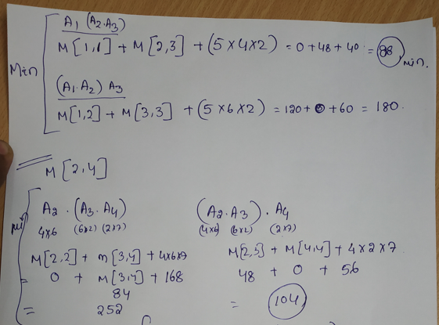

Slide 7
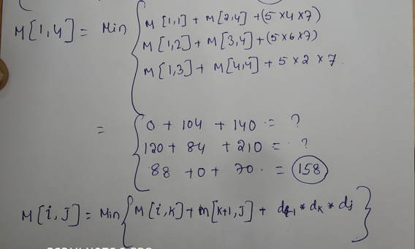

Slide 8
